Slide 1
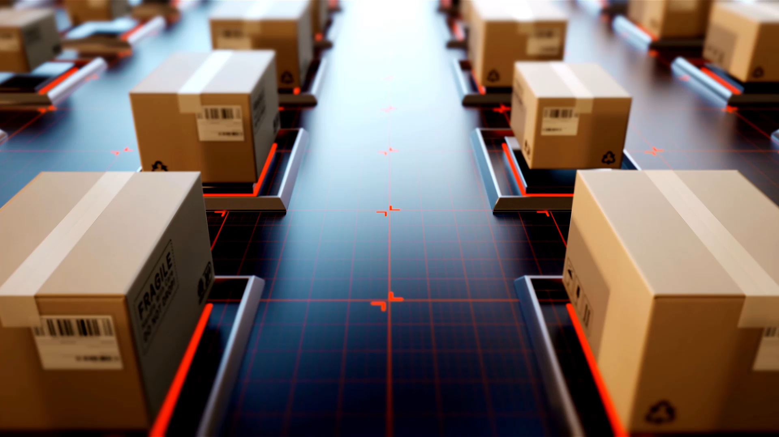
Supply chain Performance and Optmization Analysis
A Comprehensive Analysis of Product Performance , Inventory , Supplier Reliability , and Logistics Efficient

Slide 2
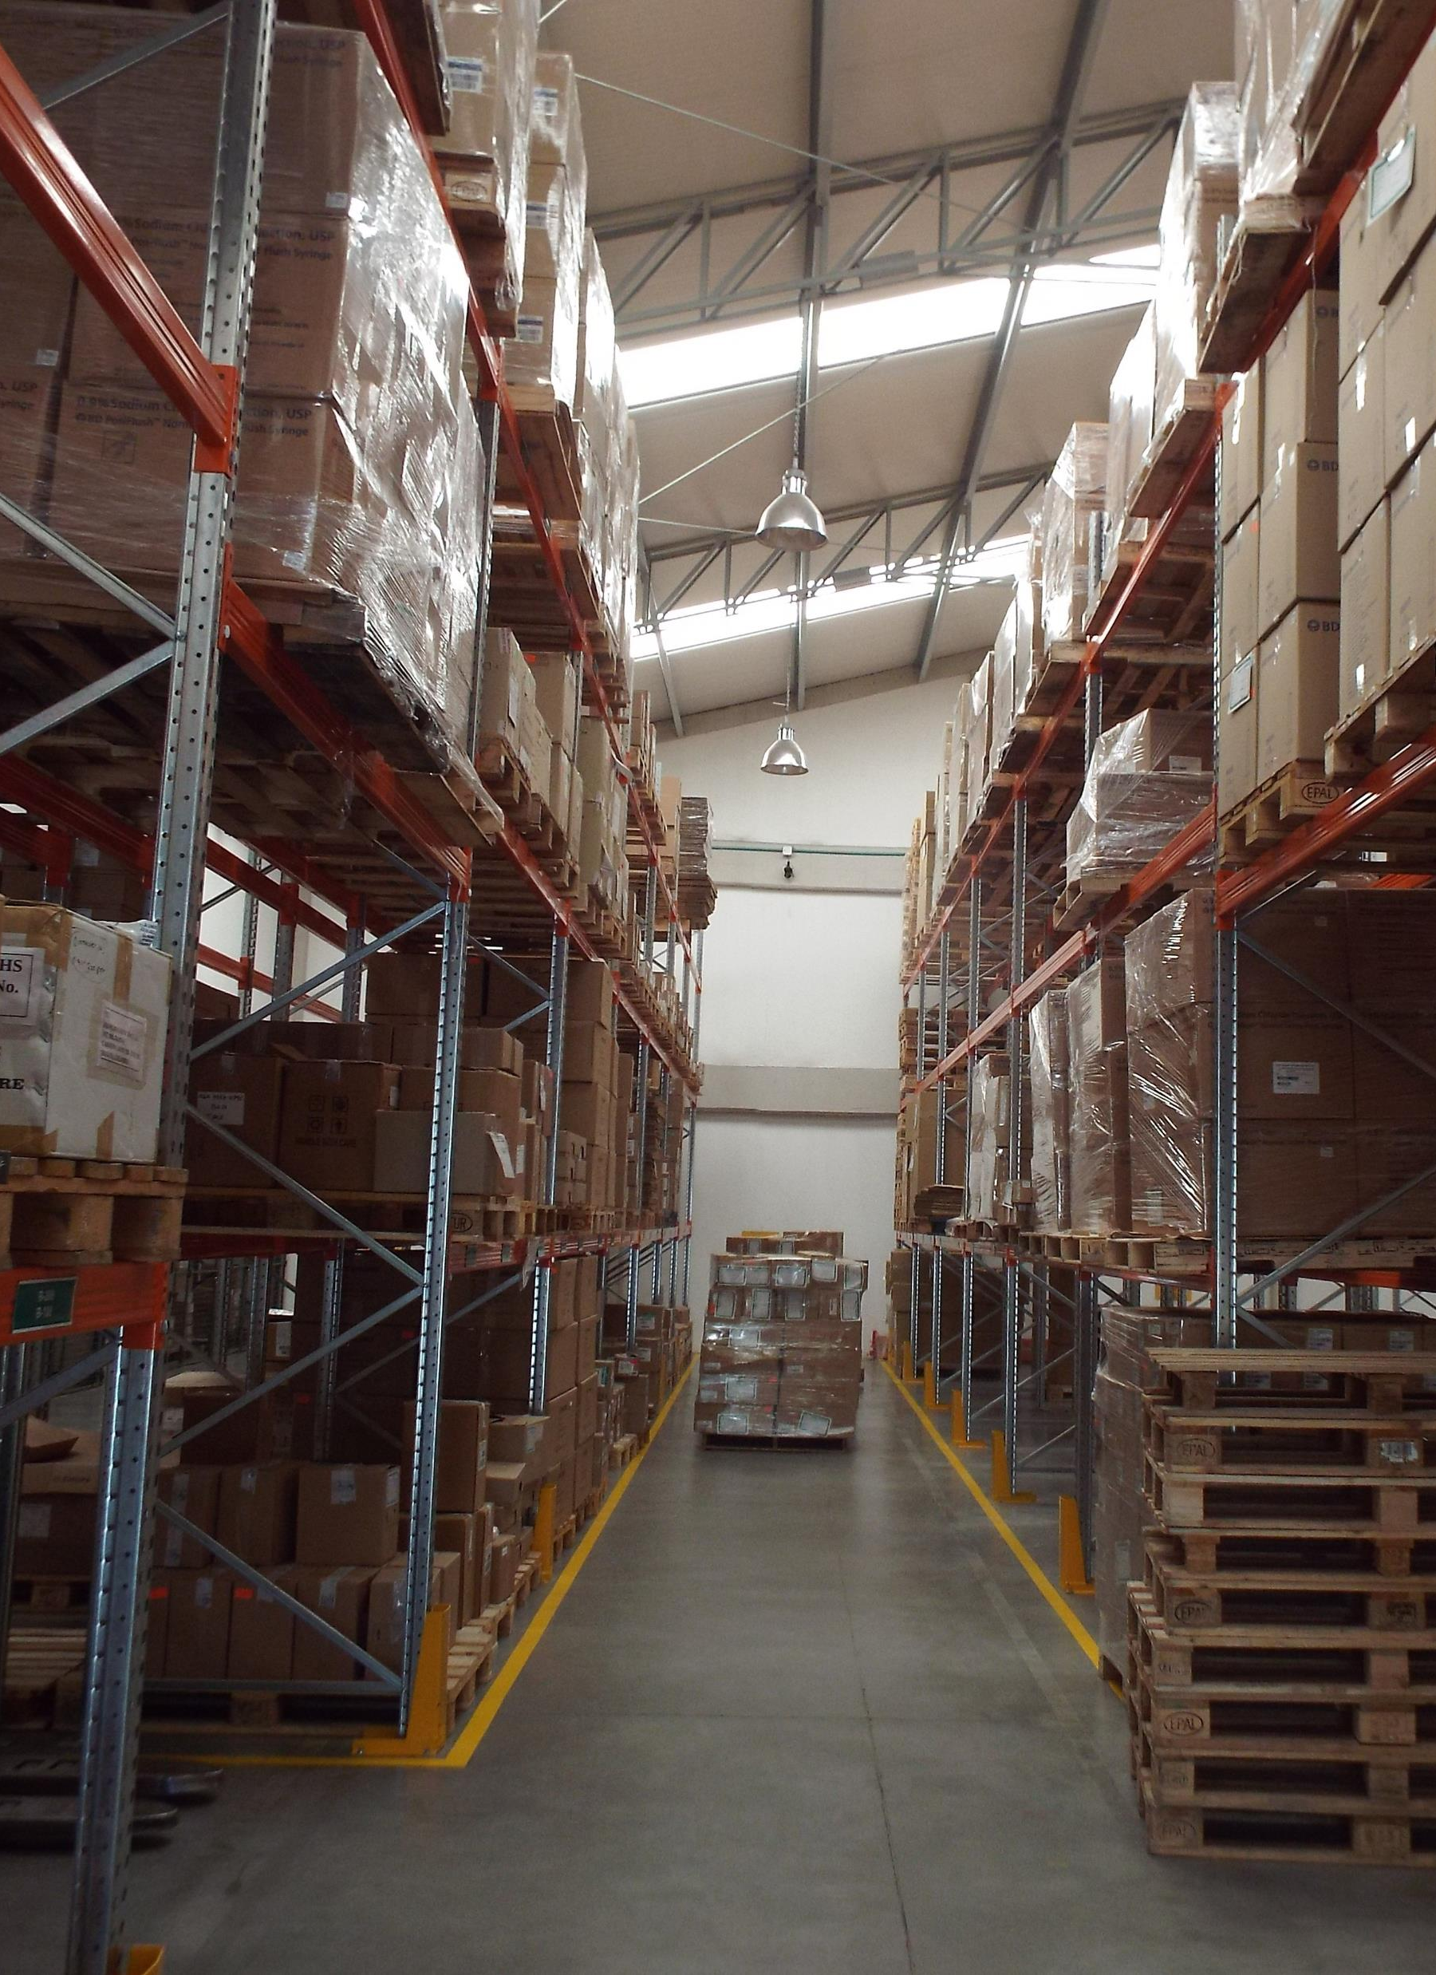
Introduction
Objective: This analysis focuses on evaluating product performance, inventory management, supplier reliability, logistics efficiency, and quality control to improve the overall supply chain process.
Scope: Key areas covered:
Product Performance
Inventory Management
Supplier Reliability
Shipping & Logistics
Lead Times & Efficiency
Defect Rates & Quality Control

Slide 3
Dataset Overview: The dataset includes various metrics such as:
Product type, SKUs, Price
Stock levels, Sales volumes, Revenue
Lead times, Defect rates, and Transportation costs

Slide 4
Product Performance
Key Questions:
Which product types generate the most revenue?
What are the best-selling products (volume & revenue)?
Insights:
Skincare, haircare, and cosmetics are the main product categories.
The dashboard shows that Skincare has the highest revenue generation with spikes up to 44k.
The best-selling SKUs based on the number of products sold are closely aligned with these revenue spikes.

Slide 5
Inventory & Stock Levels
Key Questions:
Which products are frequently out of stock or have low availability?
Are stock levels meeting demand?
Insights:
Stock Levels by product type show:
Skincare has 40 units in stock, Haircare has 34, and Cosmetics has 26.
There is a risk of stockouts for Cosmetics, which has the lowest stock, especially when demand spikes.

Slide 6
Supplier Performance
Key Questions:
Which suppliers are the most reliable in terms of lead times and costs?
How do defect rates vary between suppliers?
Insights:
Supplier 1 has the highest defect count (27), while Supplier 3 has the lowest (15).
Lead times vary across suppliers, with some taking over 22 days.
Supplier 3 is the most reliable based on low defect rates and moderate lead times.

Slide 7
Shipping & Logistics
Key Questions:
What are the average shipping times by carrier or route?
Which transportation modes have the highest costs?
Insights:
Shipping times are highest for Carrier B at 43 days, while Carrier A has the lowest time at 28 days.
Shipping costs are highest for Road transport ($161), while Sea transport is the cheapest option ($34).
To optimize costs, switching from Road to Sea for suitable products could be a cost-effective strategy.

Slide 8
Lead Times & Efficiency
Key Questions:
What is the average lead time for each product and supplier?
How do lead times impact sales and revenue?
Insights:
Lead times across products and suppliers range from 13 to 28 days.
There are clear dips in sales when lead times exceed 20 days, which suggests a negative impact on revenue.
Reducing lead times, especially for high-demand products like skincare, could lead to better sales performance.

Slide 9
Defect Rates & Quality Control
Key Questions:
Which products or suppliers have the highest defect rates?
Are there correlations between defect rates and manufacturing costs?
Insights:
Skincare has the highest defect rate (93), followed by Haircare (84), and Cosmetics (50).
Higher defect rates seem to correlate with higher manufacturing and shipping costs, which leads to lower profit margins.

Slide 10
Recommendations
Product Optimization:
Increase stock levels for high-demand products (e.g., cosmetics) to avoid stockouts.
Supplier Management:
Prioritize working with Supplier 3, which has the best balance of low defect rates and moderate lead times.
Logistics Improvements:
Shift from road to sea transport where feasible to reduce high shipping costs.
Defect Control:
Address quality issues in skincare products to reduce defect rates and associated costs.

Slide 11
Conclusion
Summary of Key Insights:
Skincare generates the most revenue, but also has the highest defect rate.
Supplier 3 and Carrier A show the best performance in terms of low lead times and defect counts.
Optimizing shipping methods and reducing lead times could improve overall supply chain efficiency.
Next Steps:
Consider automated inventory systems to manage stock levels.
Engage in contract renegotiations with suppliers that have high defect rates and lead times.

Slide 12

Q&A
Open for Questions

